Slide 1
Database Tools
Microsoft Access 2013
Lesson 15

Slide 2
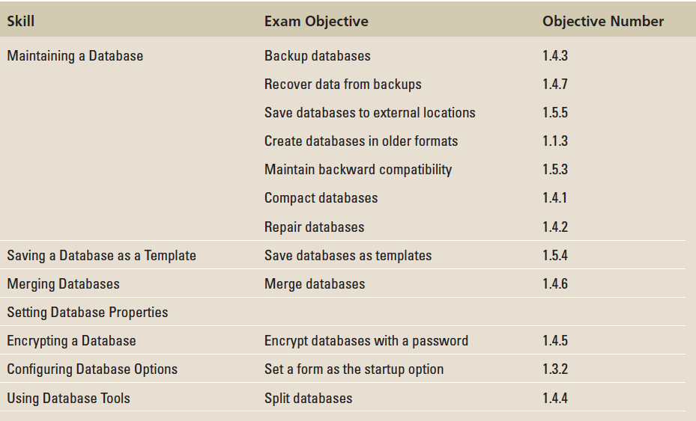
Objectives

Slide 3
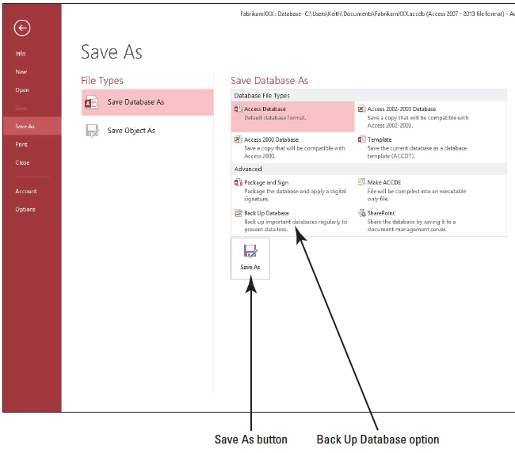
Step by Step: Back Up a Database
GET READY. Before you begin these steps, be sure to turn on and/or log on to your computer and LAUNCH Access.
OPEN Fabrikam from the data files for this lesson.
Save the database as FabrikamXXX (where XXX is your initials).
Click the FILE tab and then click Save As. The Save As menu appears, as shown at right.

Slide 4
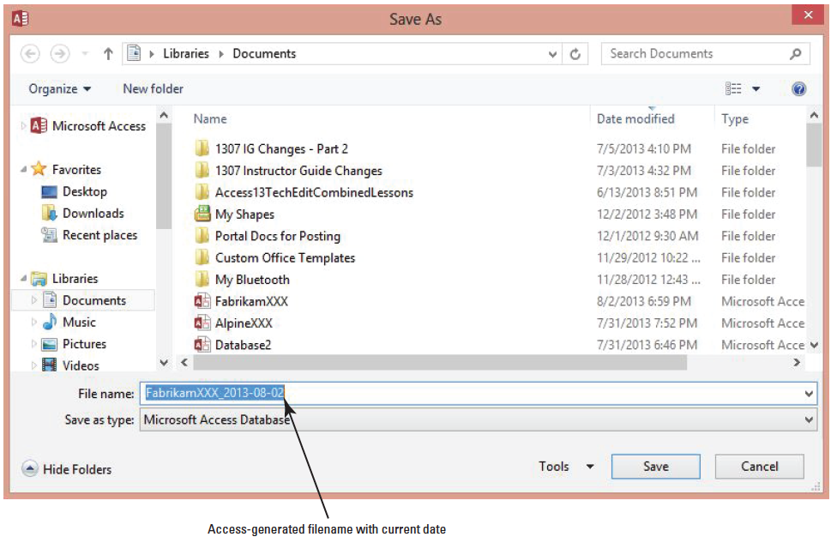
Step by Step: Back Up a Database
In the Advanced category, click Back Up Database and then click the Save As button. The Save As dialog box appears, as shown below. Notice that Access automatically adds the current date to the end of the filename.

Slide 5
Step by Step: Back Up a Database
Click the Save button to accept the generated filename and save location. You could also navigate to an external drive to save the database to an external location to increase its physical security. Data can be recovered simply by opening the database backup file you just created.
PAUSE. LEAVE the database open to use in the next exercise.

Slide 6
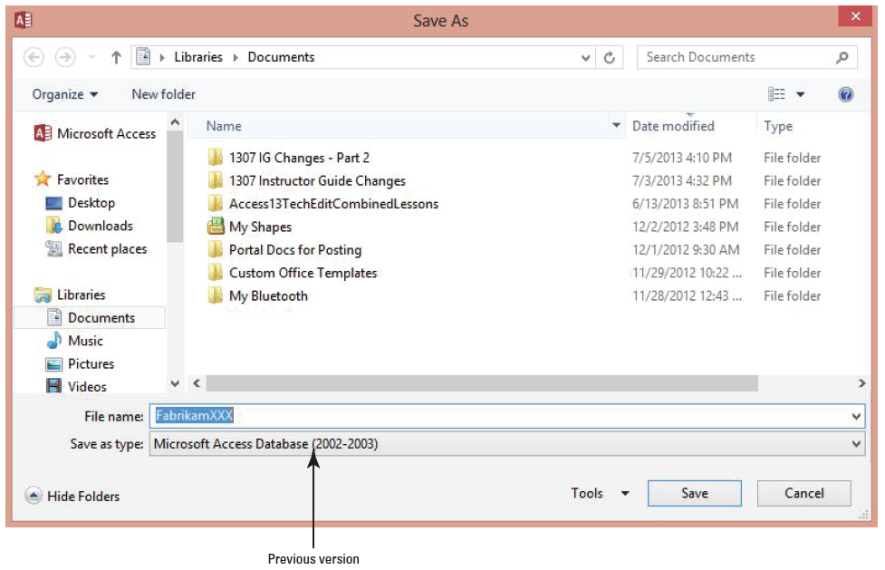
Step by Step: Save as a Previous Version
USE the database that is open from the previous exercise.
Click the FILE tab and then click Save As. The Save As menu appears.
In the Database File Types category, click Access 2002–2003 Database and then click the Save As button. The Save As dialog box appears, as shown above. Notice that Microsoft Access Database (2002–2003) is displayed in the Save as type: box.

Slide 7
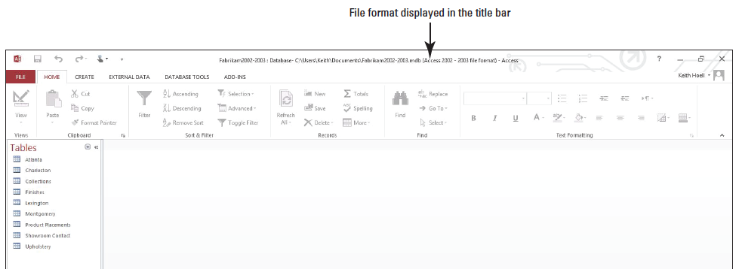
Step by Step: Save as a Previous Version
Key Fabrikam2002–2003 in the file name box.
Click the Save button. Notice the filename and format change is displayed in the title bar, as shown below.
PAUSE. LEAVE the database open to use in the next exercise.
Notes:
Take Note: After a database is saved in another format, the Navigation Pane view may need to be modified to display all database objects in the new file format.
Take Note: If an Access 2013 database file contains complex data, offline data, or attachments created in Access 2013, you will not be able to save it in a format earlier than Access 2007.

Slide 8
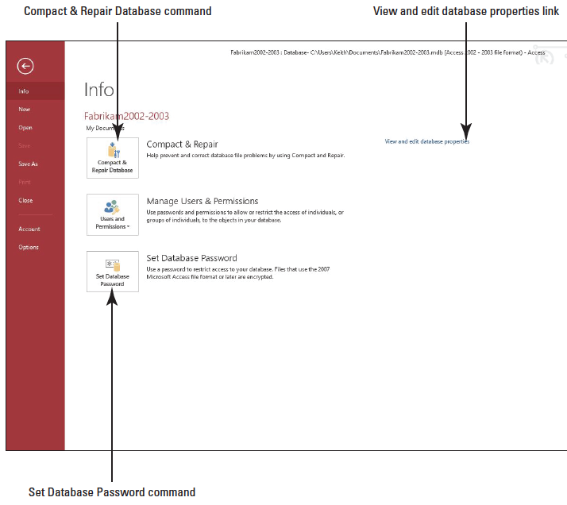
Step by Step: Compact and Repair a Database
USE the database that is open from the previous exercise.
Click the FILE tab and then click Info (if the Info menu doesn’t already appear). Select Compact & Repair Database on the Info menu that appears, as shown at right. Access compacts and repairs the database.
CLOSE the database.
PAUSE. LEAVE Access open to use in the next exercise.
Notes:
Another Way: You can set Access to compact a database every time you close it. On the FILE tab, click Options and select Current Database in the Access Options dialog box. Click the Compact on Close check box and click OK.

Slide 9
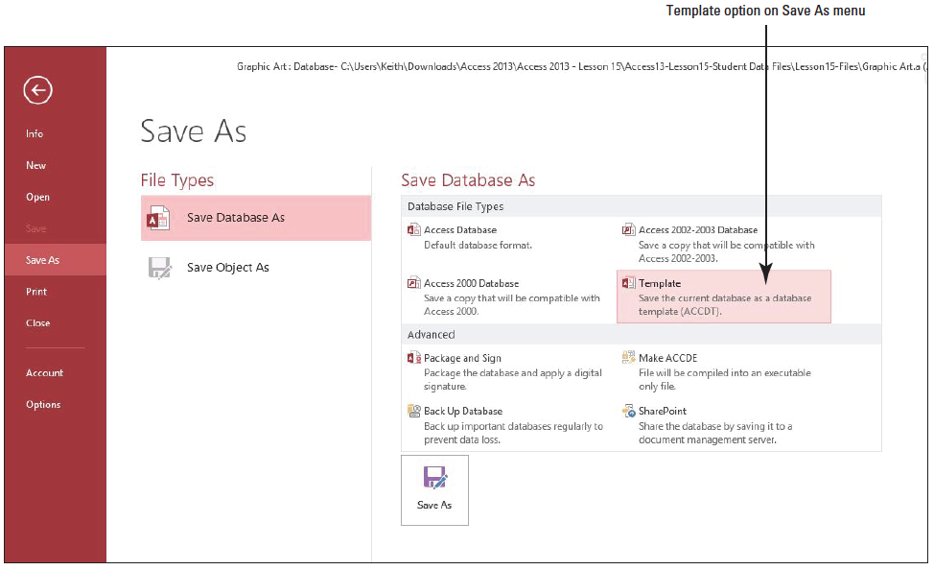
Step by Step: Save a Database as a Template
GET READY. LAUNCH Access if it is not already running.
OPEN the Graphic Art database from the data files for this lesson.
Click the FILE tab.
Click Save As to display the Save As menu. Click the Template option in the Database File Types category, as shown above.

Slide 10
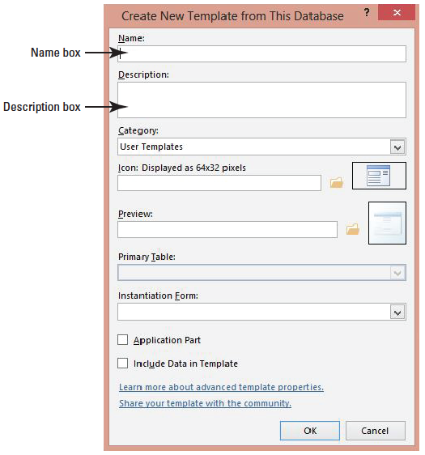
Step by Step: Save a Database as a Template
Click the Save As button. The Create New Template from This Database dialog box appears, as shown at right.
Key Photo Exhibit in the Name box.

Slide 11
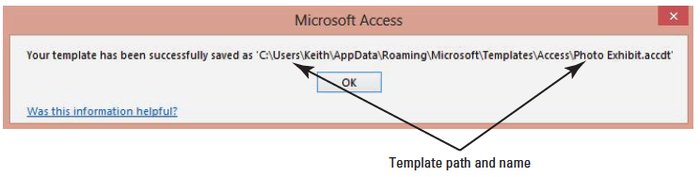
Step by Step: Save a Database as a Template
Key This template contains a standard photo exhibit table with standardized fields and a related form in the Description box. Review the other boxes and options in the Create New Template from This Database dialog box.
Click OK.
Notice the file path and name of the saved template in the message box that appears, as shown below. Click OK to close the message box.

Slide 12
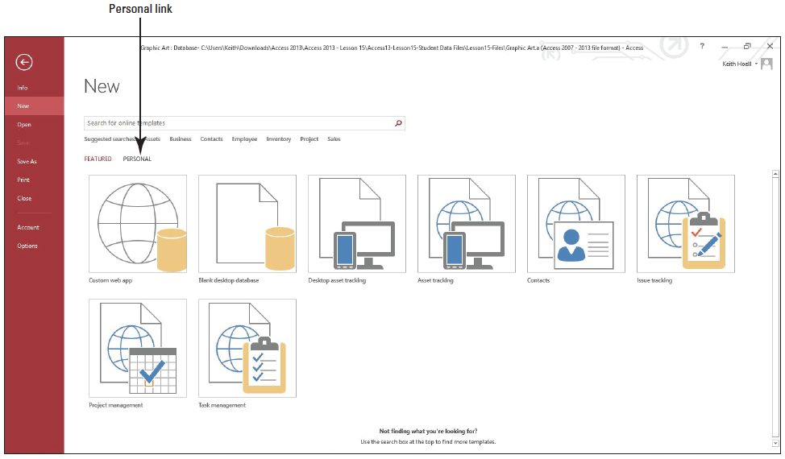
Step by Step: Save a Database as a Template
Click the FILE tab, and then click New to display the New menu. Click the Personal link, as shown below.

Slide 13
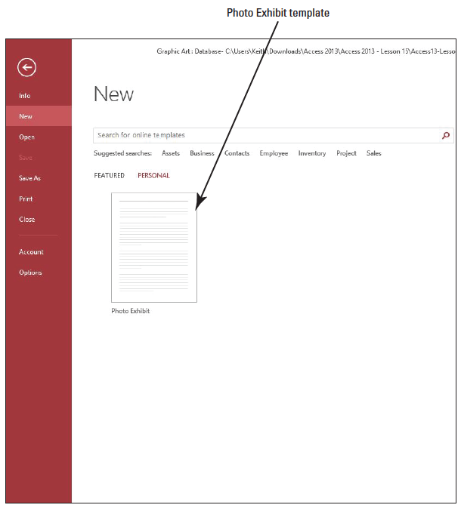
Step by Step: Save a Database as a Template
The newly created Photo Exhibit database template appears, as shown at right.
CLOSE the database.
PAUSE. LEAVE Access open to use in the next exercise.

Slide 14
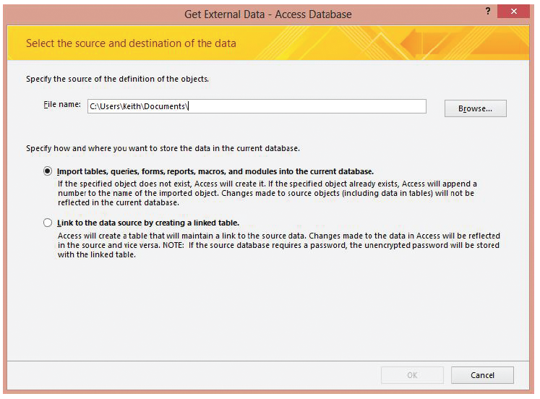
Step by Step: Merge Databases
GET READY. LAUNCH Access if it is not already running.
OPEN the Alpine data- base from the data files for this lesson.
SAVE the database as AlpineXXX (where XXX is your initials).
3.On the EXTERNAL DATA tab, in the Import & Link group, click the Access button. The Get External Data—Access Database dialog box appears, as shown above.

Slide 15
Step by Step: Merge Databases
Click Browse to open the File Open dialog box.
Use the File Open dialog box to locate the Northwind database file and then click Open. The File Open dialog box closes.

Slide 16
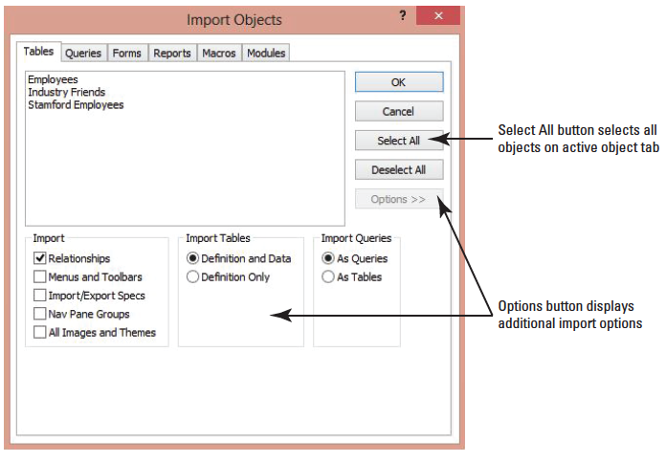
Step by Step: Merge Databases
Notice the two options you have when importing data. Click Import tables, queries, forms, reports, macros, and modules into the current database and click OK. The Import Objects dialog box appears. Click the Options button to display additional import options, as shown above. Keep the default options.

Slide 17
Step by Step: Merge Databases
Click the Select All button.
Click each object tab for tables, queries, forms, and reports, and click the Select All button as the contents for each tab are displayed to select all the objects in the Northwind database.
Click OK.
When the Save Import Steps screen appears, click Close.

Slide 18
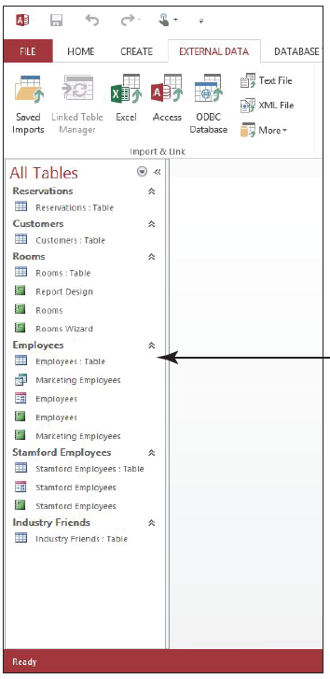
Step by Step: Merge Databases
Notice the Navigation Pane now includes objects imported from the Northwind database, as shown at right. Both databases have now been merged.
CLOSE the database.
PAUSE. LEAVE Access open to use in the next exercise.

Slide 19
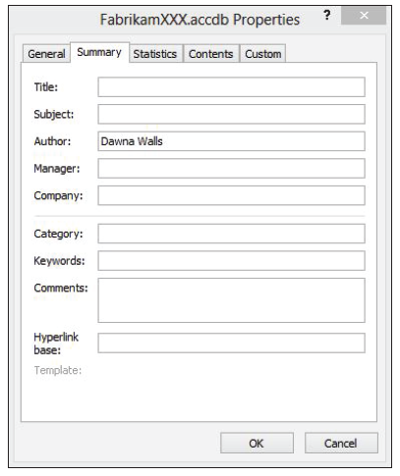
Step by Step: Set Database Properties
GET READY. LAUNCH Access if it is not already running.
OPEN the FabrikamXXX database that you saved in an earlier exercise.
Click the FILE tab and then click Info, if necessary. On the Info menu that appears, click the View and edit database properties link. The FabrikamXXX.accdb Properties dialog box appears, as shown at right.

Slide 20
Step by Step: Set Database Properties
Key Fall Collection in the Title box.
Key preview in the Subject box.
Select the text in the Author box and key [Your Name].
Key Britta Simon in the Manager box.
Key Fabrikam, Inc. in the Company box
Click the General tab. Notice that this tab displays the file type, location, and size as well as the dates the file was created, modified, and accessed.
Click the Contents tab to view a list of the types of objects within the database file.
Click OK.
PAUSE. LEAVE the database open to use in the next exercise.

Slide 21
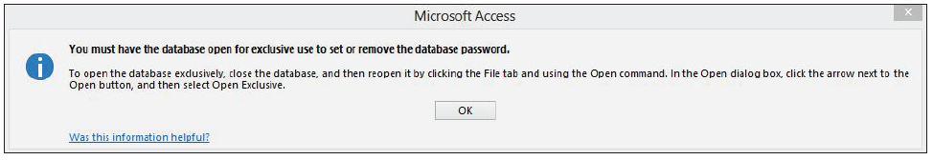
Step by Step: Encrypt and Decrypt a Database
USE the database that is open from the previous exercise.
Click the FILE tab and then click Info, if necessary. On the Info menu that appears, click the Encrypt with Password button. A Microsoft Office Access message box appears saying you must open the database in Exclusive mode, as shown below.
Click OK.
CLOSE the database but don’t close Access.
Click Open on the FILE tab. The Open menu appears.
Navigate to the data files for this lesson and select FabrikamXXX.

Slide 22
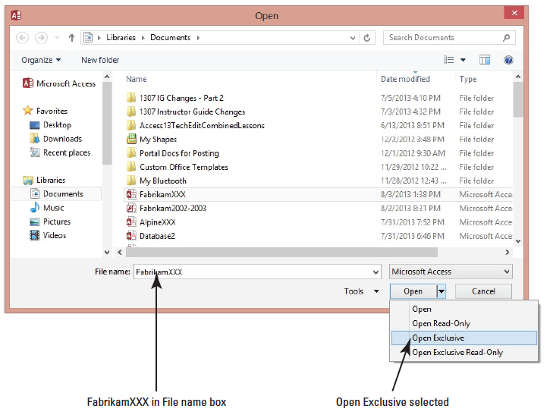
Step by Step: Encrypt and Decrypt a Database
Click the down arrow on the Open button and select Open Exclusive from the menu, as shown at right. The FabrikamXXX database file opens in exclusive mode.

Slide 23
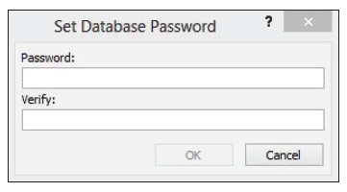
Step by Step: Encrypt and Decrypt a Database
On the FILE tab, on the Info menu, click the Encrypt with Password button. The Set Database Password dialog box appears, as shown below.
Key $Fabrikam09fc in the Password box.
Key $Fabrikam09fc in the Verify box.
Notes:
Troubleshooting: Be careful to key the passwords exactly as printed throughout this exercise to avoid error messages.

Slide 24
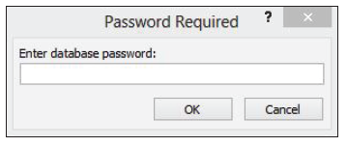
Step by Step: Encrypt and Decrypt a Database
Click OK. If you get another message box informing you that an option will be ignored, click OK. The database is now encrypted with a password.
CLOSE the database.
OPEN the database in Exclusive mode again. The Password Required dialog box appears, as shown below.
Key $Fabrikam09fc and click OK. The database opens.
Notes:
Take Note: You only need to open the database in Exclusive mode if you are going to set or unset a password. The database will be protected with the password in any mode.

Slide 25
Step by Step: Encrypt and Decrypt a Database
On the FILE tab, on the Info menu, click the Decrypt Database button. (If you hadn’t opened the database in Exclusive mode, you would get a message prompting you to do so.) The Unset Database Password dialog box appears.
Key $Fabrikam09fc and click OK. The database is not decrypted.
CLOSE the database.
OPEN the database in regular mode. Notice that a password is no longer required to open the file.
CLOSE the database.
PAUSE. LEAVE Access open to use in the next exercise.

Slide 26
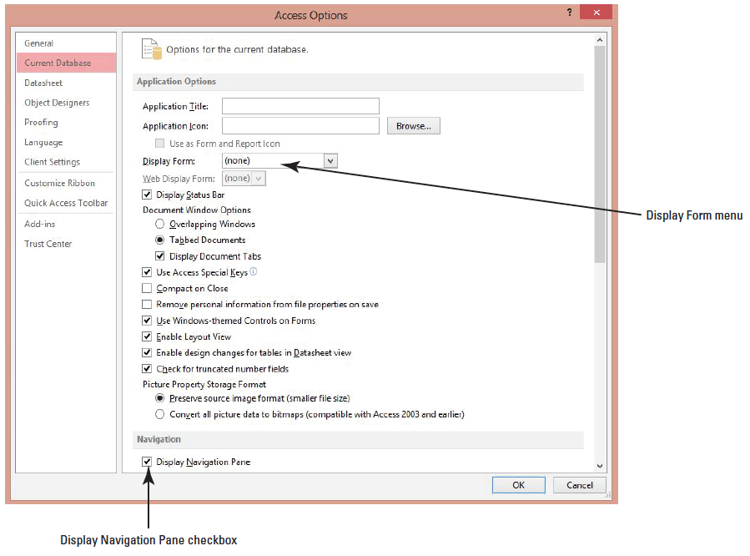
Step by Step: Configure Database Options
OPEN Fabrikam Inc from the data files for this lesson.
SAVE the database as Fabrikam IncXXX (where XXX is your initials).
Click the FILE tab and click Options. The Access Options dialog box appears.
Click the Current Database button on the left to display the Current Database menu of the Access Options dialog box, as shown above.

Slide 27
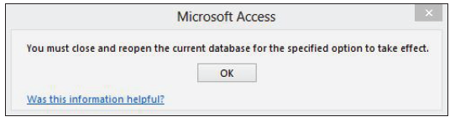
Step by Step: Configure Database Options
In the Application Options section, click the Display Form down arrow and select Showroom Contact Form from the menu.
In the Navigation section, notice that the Display Navigation Pane is turned on by default.
Click the Display Navigation Pane check box to remove the check mark and click OK. A Microsoft Access message box appears, as shown below, saying you need to close and reopen the database for the changes to take effect.

Slide 28
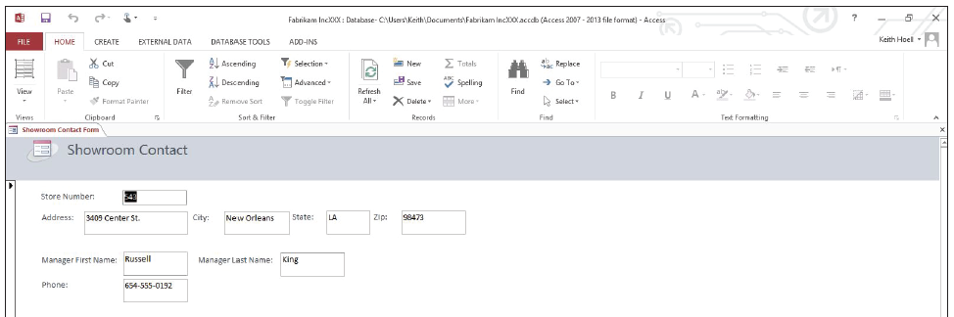
Step by Step: Configure Database Options
Click OK.
CLOSE the database.
OPEN the Fabrikam IncXXX database. Notice that the Navigation Pane is not visible and the Showroom Contact Form is displayed, as shown below.
Click the FILE tab and click Options.

Slide 29
Step by Step: Configure Database Options
Click the Current Database button on the left, if it’s not already selected.
In the Application Options section, click the Display Form down arrow and select None from the menu.
In the Navigation section, click the Display Navigation Pane check box to insert a check mark.
In the Navigation section, click the Navigation Options button. The Navigation Options dialog box appears. Notice the grouping and display options that are available and click Cancel.

Slide 30
Step by Step: Configure Database Options
Click the Object Designers button on the left.
Scroll to the bottom of the window to see the Error checking section. The Enable Error Checking options are turned on by default.
Click OK. The Microsoft Access dialog box appears again.
Click OK.
CLOSE the database.
OPEN the Fabrikam IncXXX database. Notice the Navigation Pane is displayed and the form is not.
PAUSE. LEAVE the database open to use in the next exercise.

Slide 31
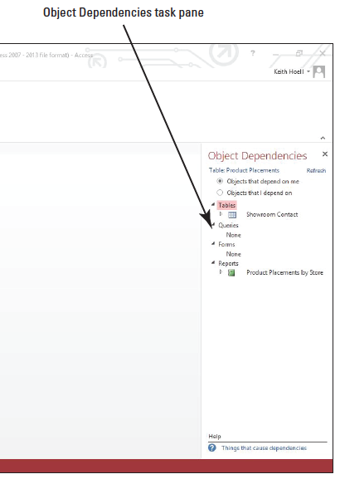
Step by Step: Identify Object Dependencies
USE the database that is open from the previous exercise.
Click the Product Placements: Table in the Navigation Pane to select it.
On the DATABASE TOOLS tab, in the Relationships group, click the Object Dependencies button. The Object Dependencies task pane displays dependency information for the selected table, as shown at right.
Notes:
Notice that the Objects that depend on me option button is selected.

Slide 32
Step by Step: Identify Object Dependencies
Click the Objects that I depend on option button. Notice the changes in the Reports section.
Click the Objects that depend on me option button. Click the right-pointing triangle beside the Showroom Contact table to see the tables and forms that depend on the Showroom Contact table.
Click the Showroom Contact link to display it in Design view where you could make any necessary changes
CLOSE the Showroom Contact table.
CLOSE the Object Dependencies task pane.
PAUSE. LEAVE the database open to use in the next exercise.

Slide 33
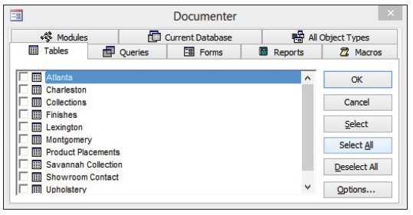
Step by Step: Use the Database Documenter
USE the database that is open from the previous exercise.
On the DATABASE TOOLS tab, in the Analyze group, click the Database Documenter button. The Documenter dialog box appears, as shown below.
Click the All Object Types tab.
Click the Tables tab.

Slide 34
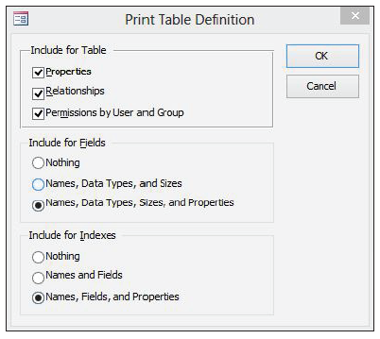
Step by Step: Use the Database Documenter
Click the Showroom Contact check box in the Tables list.
Click the Options button. The Print Table Definition dialog box appears, as shown at right.
Click OK to close the Print Table Definition dialog box.

Slide 35
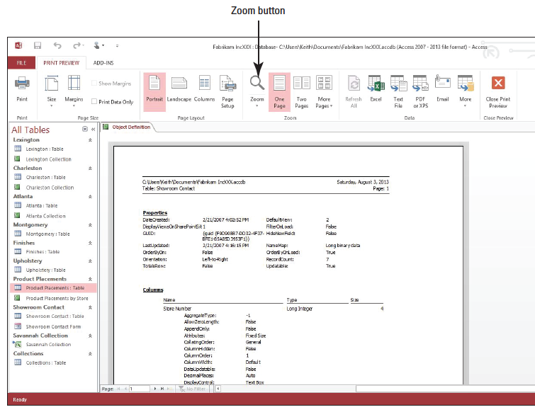
Step by Step: Use the Database Documenter
Click OK to close the Documenter dialog box. The Object Definition report appears in Print Preview.
Click the Zoom button in the Zoom group to view the report, as shown at right. At this point, you could print the report or make any changes to the layout and then print it.

Slide 36
Step by Step: Use the Database Documenter
Click the Next Page button on the page navigation bar until you reach page 4. Notice the relationship diagram included in the report.
Click the Close Print Preview button.
PAUSE. LEAVE the database open to use in the next exercise.
Notes:
Take Note: Some object definitions can be several pages long, so it is a good idea to check the length of the report before printing.

Slide 37
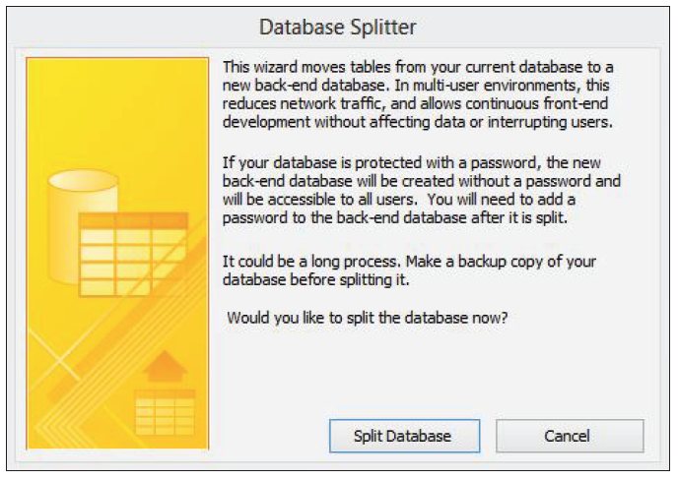
Step by Step: Split a Database
USE the database that is open from the previous exercise.
On the DATABASE TOOLS tab, in the Move Data group, click the Access Database button. The Database Splitter Wizard appears, as shown at right.

Slide 38
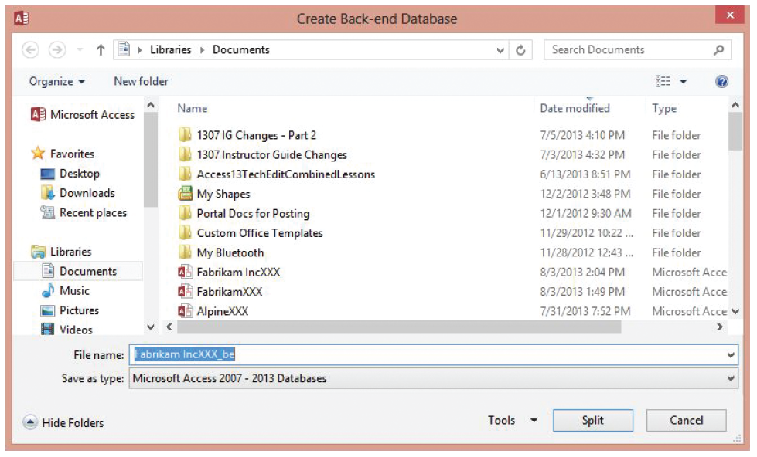
Step by Step: Split a Database
Click the Split Database button. The Create Back-end Database dialog box appears, as shown below.

Slide 39
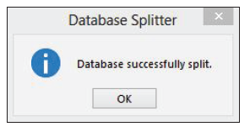
Step by Step: Split a Database
Navigate to the location where you want to save the back-end file and click Split. After a few moments, the Database Splitter message box appears, as shown at right.
Click OK.
CLOSE the database.
OPEN FabrikamIncXXX_be. Notice that it contains only the tables for the database.
CLOSE the database.
CLOSE Access.

Slide 40
Skill Summary

